Slide 1



Manufacturing
Downtime Analysis
An analytical review of your factory Downtime causes & impact and how to optimize your manufacturing process.
Under the Supervision of:
Eng. Mahmoud Emad
By:
Randa Alaa El-Din
Nada Ashraf
Esraa Rashwan
Sherif El-Shafey
Eman Talaat
Mennatullah Ahmed

Slide 2





Project Overview
Line productivity:
Date.
Product.
Batch “Primary Key”.
Operator.
Start Time
End Time
Overview
Dataset
Product
The dataset shows the operation time and downtime of a soda drinks factory through 4 days.
The dataset provides data about each production batch containing:
Batch no.
Products being processed.
Operators working on it.
The stopping event, referred to as (event).
The reason for each event, referred to as (factor).
Products:
Product.
Flavor.
Size.
Min Batch Time
Operator
Downtime Factors:
Factor.
Description.
Operator Error.
Factors
Solutions

Slide 3
Project Overview
Overview
Line Downtime
Dataset
Product
The dataset shows the operation time and downtime of a soda drinks factory through 4 days.
The dataset provides data about each production batch containing:
Batch no.
Products being processed.
Operators working on it.
The stopping event, referred to as (event).
The reason for each event, referred to as (factor).
Operator
Factors
Solutions

Slide 4

Project Overview
Overview
Standard industry metrics.
Product
According to Soda industry OEE (Overall Equipment Effectiveness), we have 4 main critical metrics:
Availability of the machines.
Downtime Rate: the percentage of time a system is unavailable or non-operational.
MTTR (Mean Time To Repair): average time to recover from a failure. Lower is better.
MTBF (Mean Time Between Failures): average time between failures. Higher is better.
Operator
Factors
Solutions

Slide 5

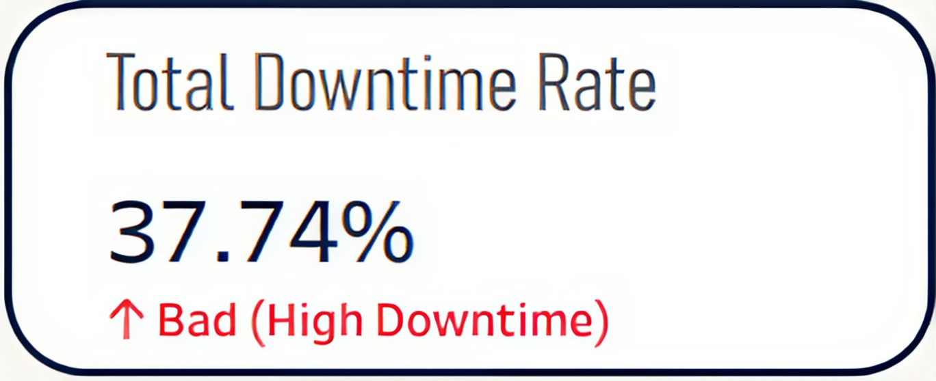
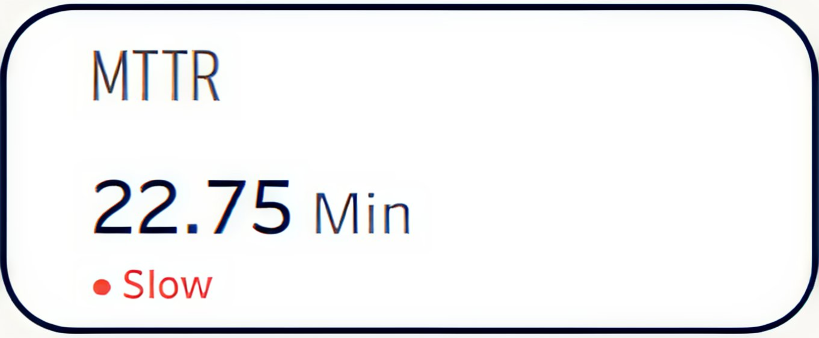
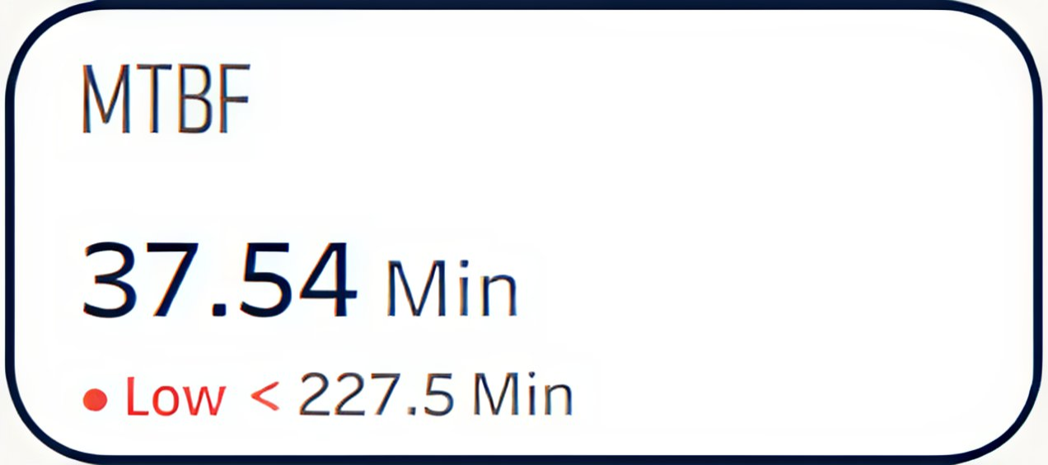
Project Overview
Overview
Fieldes Created
Product
The dataset needed further adjustments before work:
Manufacturing Time (min).
Calculated fields (most significant):
MTBF.
MTTR.
Total Impact (Equation scoring the total impact of each factor on Production considering both the No. of Events & Total Downtime).
Operator
Factors
Solutions

Slide 6

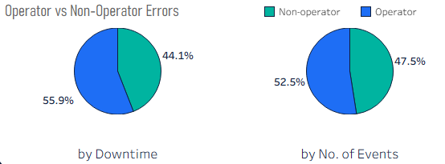
Project Overview
Overview
How much are operators contributing to the problem?
Product
The data obviously shows that the errors are mainly driven by operators.
Operator
Factors
Solutions

Slide 7

Overview
Now let’s zoom into the problem!
Product
Operator
Factors
Solutions

Slide 8
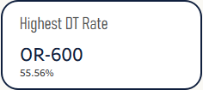
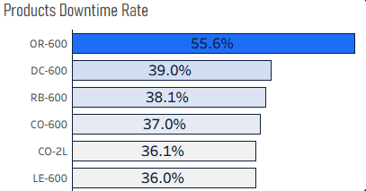
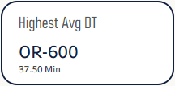
Now let’s zoom into the problem!
Overview
Products
Product
Product with highest Downtime Rate and Average Downtime is OR-600.
Operator
Factors
Solutions

Slide 9
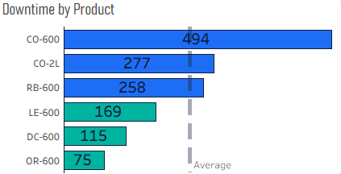
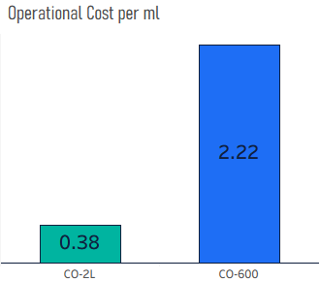
Now let’s zoom into the problem!
Overview
Product
Product
While CO-600 has the most Total Downtime, having about 7 times operational cost more than the 2L size of the same product.
Operator
Factors
Solutions

Slide 10
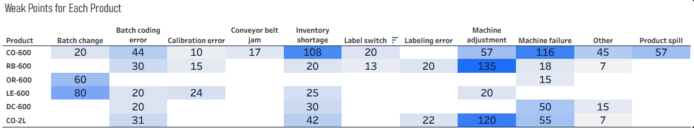
Now let’s zoom into the problem!
Overview
Product
Product
And that is due to its exposure to almost ALL types of Downtime Factors.
Operator
Factors
Solutions

Slide 11
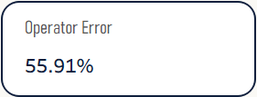
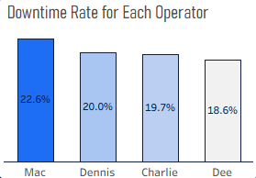
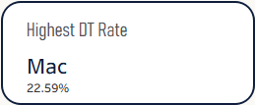
Overview
Now let’s zoom into the problem!
Product
Operators
Operator
We have mainly 4 operators; Mac, Charlie, Dee & Dennis.
The one operator in interest is Mac, with the highest Downtime Rate.
Factors
Solutions

Slide 12
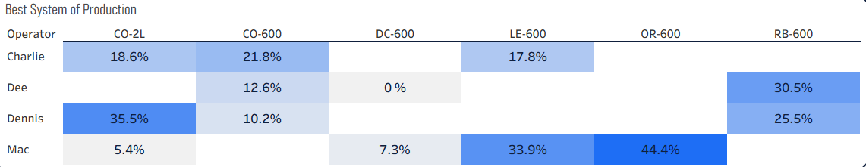
Overview
Now let’s zoom into the problem!
Product
Operator
Operator
But there might be a good reason for this, seeing how many products Mac is handling.
Factors
Solutions

Slide 13
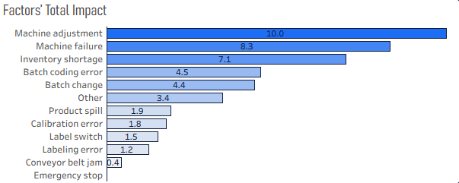
Overview
Product
Now let’s zoom into the problem!
Operator
Factors
Factors
Considering both Downtime Duration & No. of Events for each of the factors causing the errors, Machine related factors are the most impactful ones.
Solutions
But solving only those Problems will not be enough!

Slide 14
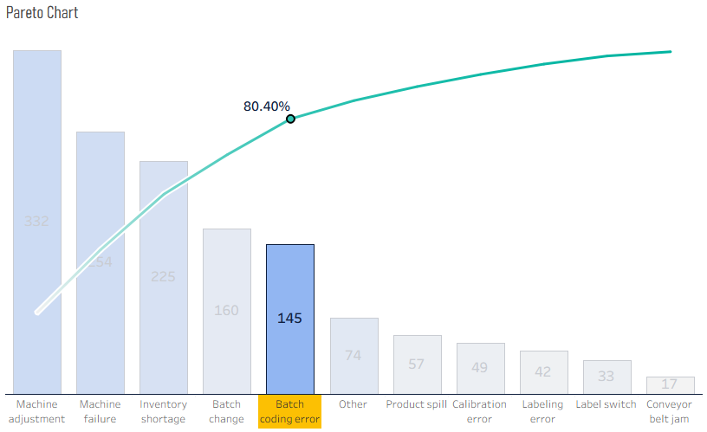

Overview
Product
Now let’s zoom into the problem!
Operator
Factors
Factors
Let's take a closer look!
Working on those five:
Machine adjustment.
Machine failure.
Inventory shortage.
Batch change.
Batch coding error.
will save you 80% of your time!
Solutions

Slide 15

Overview
Product
Operator
Factors
Here comes what we recommend…
Solutions

Slide 16
Overview
Product
Operator
Here comes what we recommend…
Factors
Our solutions
Solutions
Start by working on the five main factors:
Machine adjustment
Machine failure.
Inventory shortage.
Batch change. (it’s recommended to reduce the time of changing products between batches).
Batch coding error.

Slide 17

Overview
Product
Operator
Here comes what we recommend…
Factors
Our solutions
Solutions
Reduce the load on Mac by transforming OR-600 to another operator to work on.
This operator is recommended to be Dee (the one with lowest Downtime Rate).
This also predicted to reduce the Downtime of OR-600 (the highest Downtime Rate product).

Slide 18
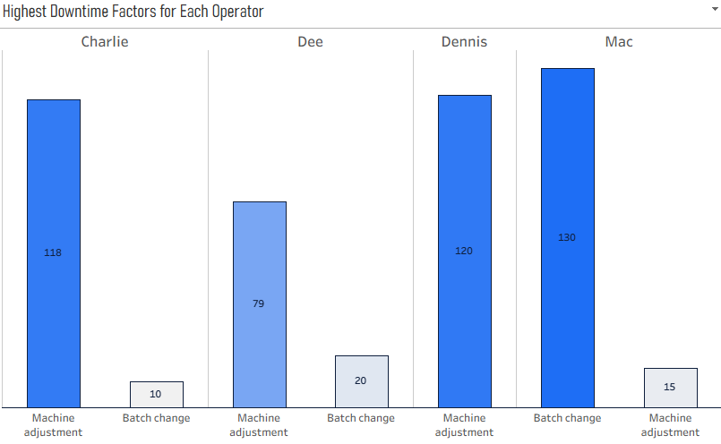
Overview
Product
Operator
Here comes what we recommend…
Factors
Our solutions
Solutions
All workers need more training on Machine Adjustment, especially Dennis.

Slide 19

Overview
Product
Operator
Here comes what we recommend…
Factors
Our solutions
Solutions
Reconsider the redistribution of CO sizes Production (as CO-600 has the most Total Downtime, and about 7 times operational cost more than the 2L size of the same product).

Slide 20
Overview
Product
Operator
Factors
Solutions
Small adjustments
for a big difference, right?

Slide 21
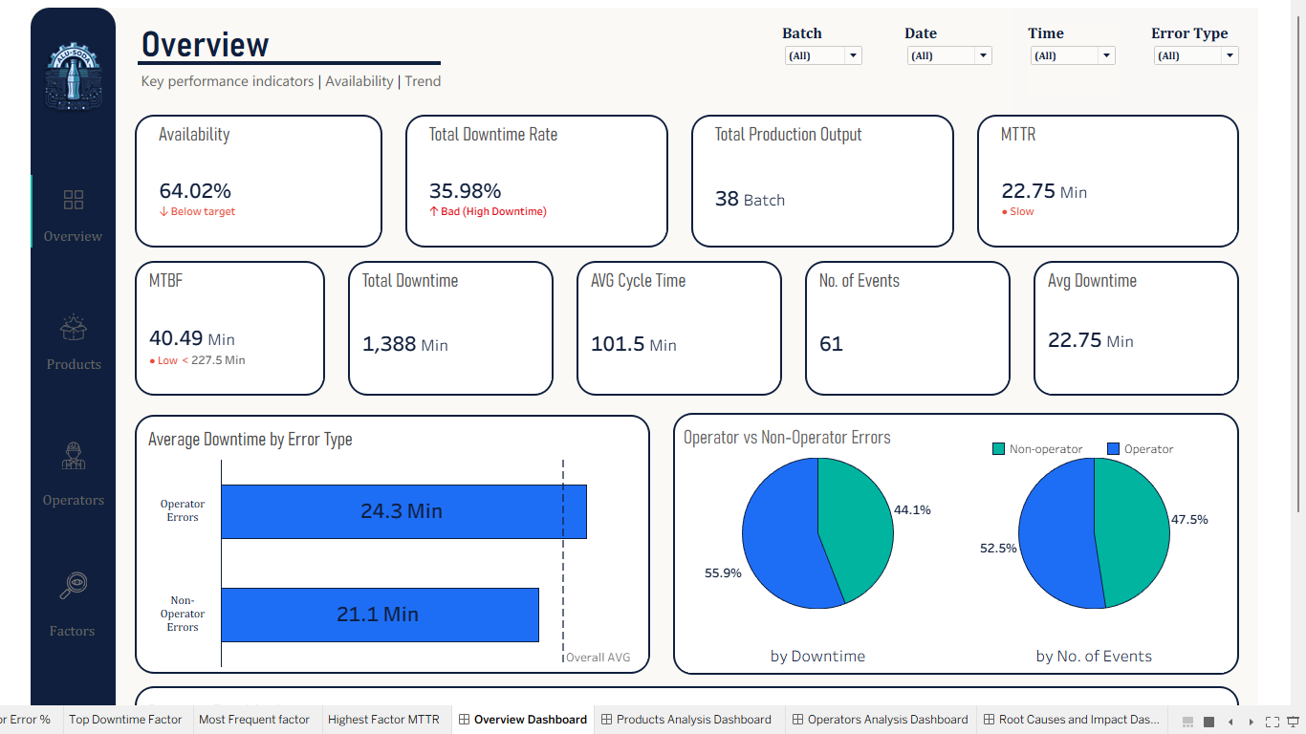
You can find more details and insights in the Dashboard Here

Slide 22

Overview
Product
Operator
Factors
Solutions
Thank You

